Slide 1
CS 3104 – OPERATING SYSTEMS
Chapter 7
Synchronization Examples

Slide 2
CHAPTER 7: SYNCHRONIZATION EXAMPLES
Classical Problems of Synchronization
Synchronization within the Kernel
POSIX Synchronization
Synchronization in Java
Alternative Approaches

Slide 3
OBJECTIVES
Explain the bounded-buffer, readers-writers, and dining philosophers synchronization problems.
Describe the tools used by Linux and Windows to solve synchronization problems.
Illustrate how POSIX and Java can be used to solve process synchronization problems.

Slide 4
CLASSICAL PROBLEMS OF SYNCHRONIZATION
Classical problems used to test newly-proposed synchronization schemes:
Bounded-Buffer Problem
Readers-Writers Problem
Dining-Philosophers Problem

Slide 5
CLASSICAL PROBLEMS OF SYNCHRONIZATION
BOUNDED-BUFFER PROBLEM
It is one of the classical problems of synchronization.
It is also known as the producer-consumer problem.
There is a bounded buffer of n slots and each slot is capable of storing one unit of data.
There are two processes running, producer and consumer, which are operating on the buffer.
Producer tries to insert or write data into an empty slot of the buffer.
Consumer tries to remove or read data from a filled slot in the buffer.
The two processes will not produce the expected output if they are being executed concurrently.
There needs to be a way to make the producer and consumer work in an independent manner.

Slide 6
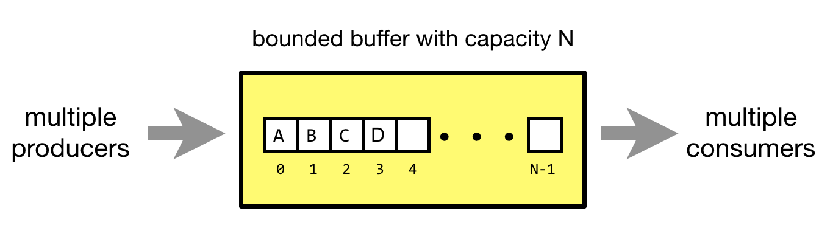
CLASSICAL PROBLEMS OF SYNCHRONIZATION
BOUNDED-BUFFER PROBLEM
bounded buffer with capacity n
producer
consumer
n - 1

Slide 7
CLASSICAL PROBLEMS OF SYNCHRONIZATION
BOUNDED-BUFFER PROBLEM
The producer and consumer processes share the following data structures:
Binary semaphore mutex controls access to the critical section.
Two counting semaphores:
full: to keep track of the current number of full buffer (initialized to 0)
empty: to keep track of the current number of empty buffer (initialized to n)
Producer must block if the buffer is full.
Consumer must block if the buffer is empty.
int n;
semaphore mutex = 1;
semaphore empty = n;
semaphore full = 0;
n buffers, each can hold one item
Semaphore mutex initialized to the value 1
Semaphore empty initialized to the value n
Semaphore full initialized to the value 0

Slide 8
CLASSICAL PROBLEMS OF SYNCHRONIZATION
BOUNDED-BUFFER PROBLEM
The structure of the producer process:
while (true) {
... /* produce an item in next_produced */
...
wait(empty); /* wait until empty>0 and then decrement empty */
wait(mutex); /* acquire lock */
... /* add next_produced to the buffer */
...
signal(mutex); /* release lock */
signal(full); /* increment full */
}
Notes:
Looking at the above code for a producer, we can see that a producer first waits until there is at least one empty slot.
Then it decrements the empty semaphore because, there will now be one less empty slot, since the producer is going to insert data in one of those slots.
Then, it acquires lock on the buffer, so that the consumer cannot access the buffer until producer completes its operation.
After performing the insert/write operation, the lock is released and the value of full is incremented because the producer has just filled a slot in the buffer.

Slide 9
CLASSICAL PROBLEMS OF SYNCHRONIZATION
BOUNDED-BUFFER PROBLEM
The structure of the consumer process:
while (true) {
wait(full); /* wait until full>0 and then decrement full */
wait(mutex); /* acquire lock */
... /* remove an item from buffer to next_consumed */
...
signal(mutex); /* release lock */
signal(empty); /* increment empty */
... /* consume the item in next_consumed */
... }
Notes:
The consumer waits until there is at least one full slot in the buffer.
Then it decrements the full semaphore because the number of occupied slots will be decreased by one, after the consumer completes its operation.
After that, the consumer acquires lock on the buffer.
Following that, the consumer completes the removal operation so that the data from one of the full slots is removed.
Then, the consumer releases the lock.
Finally, the empty semaphore is incremented by 1, because the consumer has just removed data from an occupied slot, thus making it empty.

Slide 10
CLASSICAL PROBLEMS OF SYNCHRONIZATION
READERS-WRITERS PROBLEM
Another example of a classic synchronization problem
There is a shared resource which should be accessed by multiple processes.
There are two types of processes: reader and writer.
Any number of readers can read from the shared resource simultaneously.
But only one writer can write to the shared resource.
When a writer is writing data to the resource, no other process can access the resource.
A writer cannot write to the resource if there are readers accessing the resource.

Slide 11
CLASSICAL PROBLEMS OF SYNCHRONIZATION
READERS-WRITERS PROBLEM: PARAMETERS
One set of data is shared among a number of concurrent processes
Readers: only read the data set, they do not perform any updates
Allow multiple readers to read at the same time
Writers: can both read and write
Only one single writer can access the shared data at the same time
If a process is writing, no other process can read it
If at least one reader is reading, no other process can write

Slide 12
CLASSICAL PROBLEMS OF SYNCHRONIZATION
READERS-WRITERS PROBLEM: EXAMPLE SITUATION
A FILE shared between many people:
If one of the people tries editing the file, no other person should be reading or writing at the same time, otherwise changes will not be visible to him/her.
However, if some person is reading the file, then others may read it at the same time.

Slide 13
CLASSICAL PROBLEMS OF SYNCHRONIZATION
READERS-WRITERS PROBLEM: SHARED DATA
Semaphore rw_mutex initialized to 1
Semaphore mutex initialized to 1
Integer read_count initialized to 0

Slide 14
CLASSICAL PROBLEMS OF SYNCHRONIZATION
READERS-WRITERS PROBLEM
Structure of a writer process:
while (true) { /* writer requests entry to critical section */
wait(rw_mutex); /* decrement semaphore value */
... /* writing is performed */
...
/* writer leaves the critical section */
signal(rw_mutex); /* increment semaphore value */
}

Slide 15
CLASSICAL PROBLEMS OF SYNCHRONIZATION
READERS-WRITERS PROBLEM
Structure of a reader process:
while (true){
wait(mutex);/* Reader wants to enter the critical section */
read_count++; /* Increase the number of readers by 1 */ if (read_count == 1) /* there is at least 1 reader in the critical section */
wait(rw_mutex);
signal(mutex); /* other readers can enter while current reader is in the critical section */
... /* reading is performed */
...
wait(mutex); /* reader wants to leave */ read count--; if (read_count == 0) /* no reader is left in the critical section */
signal(rw_mutex); /* writers can enter */
signal(mutex); /* reader leaves */
}

Slide 16
READERS-WRITERS PROBLEM VARIATIONS
Several variations of how readers and writers are considered (all involve some form of priorities)
First variation:
no reader is kept waiting unless writer has permission to use shared object
Second variation:
once writer is ready, it performs the write ASAP
Both may have starvation leading to even more variations
Problem is solved on some systems by kernel providing reader-writer locks

Slide 17
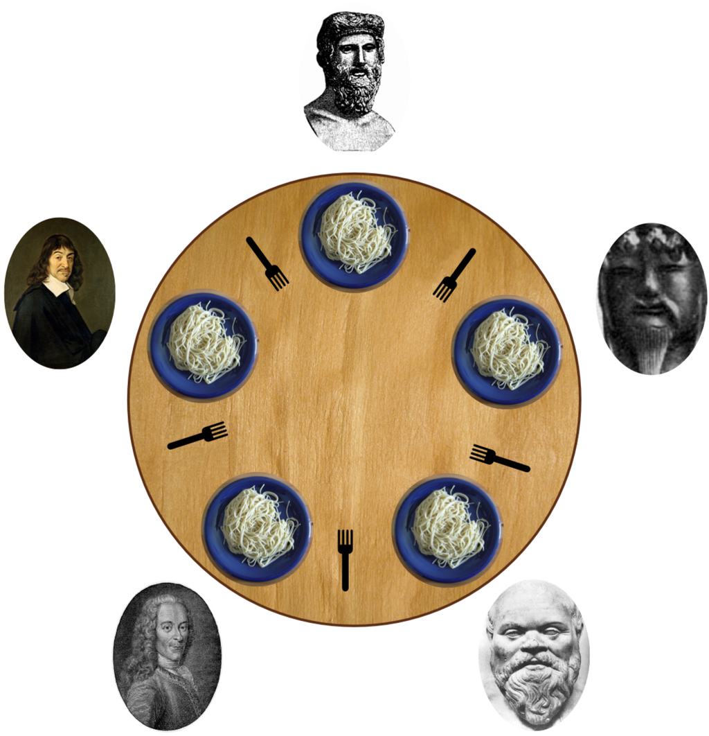

CLASSICAL PROBLEMS OF SYNCHRONIZATION
DINING-PHILOSOPHERS PROBLEM
This is another classic synchronization problem.
It is used to evaluate situations where there is a need:
of allocating multiple resources to multiple processes
in a deadlock-free and starvation-free manner

Slide 18
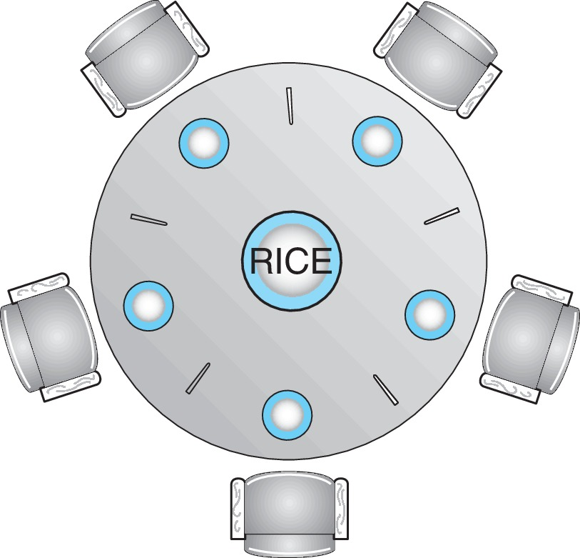
CLASSICAL PROBLEMS OF SYNCHRONIZATION
DINING-PHILOSOPHERS PROBLEM
Consider five philosophers who spend their lives thinking and eating alternatively:
The philosophers share a circular table surrounded by five chairs, each belonging to one philosopher.
In the center of the table is a bowl of rice, and the table is laid with five single chopsticks (shown in the figure).
When a philosopher thinks, she does not interact with her colleagues.
From time to time, a philosopher gets hungry and tries to pick up the two chopsticks that are closest to her (the chopsticks that are between her and her left and right neighbors).
A philosopher may pick up only one chopstick at a time.
Obviously, she cannot pick up a chopstick that is already in the hand of a neighbor.
When a hungry philosopher has both her chopsticks at the same time, she eats without releasing the chopsticks.
When she is finished eating, she puts down both chopsticks and starts thinking again.

Slide 19
CLASSICAL PROBLEMS OF SYNCHRONIZATION
DINING-PHILOSOPHERS PROBLEM
Philosophers spend their lives alternating thinking and eating
Don’t interact with their neighbors
Occasionally try to pick up 2 chopsticks (one at a time) to eat from bowl
Need both to eat, then release both when done
In the case of 5 philosophers:
Shared data
Bowl of rice (data set)
Semaphore chopstick [5] initialized to 1

Slide 20
DINING-PHILOSOPHERS PROBLEM ALGORITHM
Semaphore Solution
The structure of Philosopher i:
while (true){
wait (chopstick[i] );
wait (chopstick[(i + 1) % 5]);
/* eat for awhile */
signal (chopstick[i] );
signal (chopstick[(i + 1) % 5]);
/* think for awhile */
}
What is the problem with this algorithm?

Slide 21
DINING-PHILOSOPHERS PROBLEM ALGORITHM
Semaphore Solution
Difficulty with the SEMAPHORE SOLUTION:
This solution makes sure that no two neighboring philosophers can eat at the same time.
But this solution can lead to a deadlock.
This may happen if all the philosophers pick their left chopstick simultaneously.
Then none of them can eat and deadlock occurs.
Several possible remedies to the deadlock problem:
There should be at most four philosophers on the table.
Allow a philosopher to pick up her chopsticks ONLY if both are available at the same time.
An even-numbered philosopher should pick up the right chopstick and then the left chopstick, whereas an odd-numbered philosopher should pick up the left chopstick and then the right chopstick.

Slide 22
DINING-PHILOSOPHERS: MONITOR SOLUTION – P1
monitor DiningPhilosophers
{
enum {THINKING, HUNGRY, EATING) state [5] ;
condition self [5];
void pickup (int i) {
state[i] = HUNGRY;
test(i);
if (state[i] != EATING)
self[i].wait;
}
void putdown (int i) {
state[i] = THINKING;
/* test left and right neighbors */
test((i + 4) % 5);
test((i + 1) % 5);
}

Slide 23
DINING-PHILOSOPHERS: MONITOR SOLUTION – P2
void test(int i) {
if ((state[(i + 4) % 5] != EATING) &&
(state[i] == HUNGRY) &&
(state[(i + 1) % 5] != EATING) )
{
state[i] = EATING;
self[i].signal();
}
}
initialization_code() {
for (int i = 0; i < 5; i++)
state[i] = THINKING;
}
}

Slide 24
DINING-PHILOSOPHERS: MONITOR SOLUTION
Each philosopher i invokes the operations pickup() and putdown() in the following sequence:
DiningPhilosophers.pickup(i);
…
/** EAT **/
…
DiningPhilosophers.putdown(i);
No deadlock, but starvation is possible

Slide 25
KERNEL SYNCHRONIZATION: WINDOWS
Uses interrupt masks to protect access to global resources on uniprocessor systems
Uses spinlocks on multiprocessor systems
Spinlocking-thread will never be preempted
Also provides dispatcher objects which may act mutexes, semaphores, events, and timers
Events
An event acts much like a condition variable
Timers notify one or more thread when time expired
Dispatcher objects either signaled-state (object available) or non-signaled state (thread will block)

Slide 26
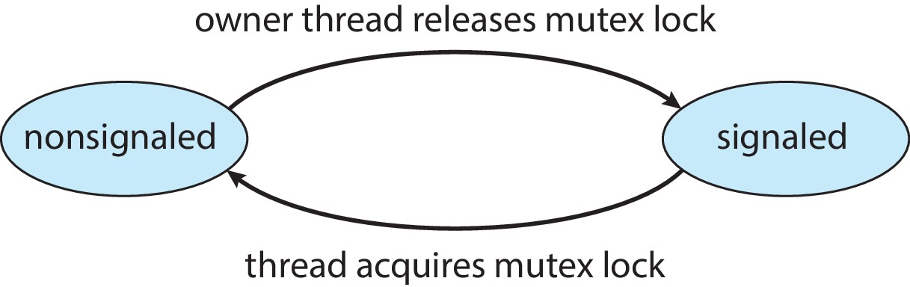
KERNEL SYNCHRONIZATION: WINDOWS
Mutex dispatcher object

Slide 27
LINUX SYNCHRONIZATION
Linux:
Prior to kernel Version 2.6, disables interrupts to implement short critical sections
Version 2.6 and later, fully preemptive
Linux provides:
semaphores
atomic integers
spinlocks
reader-writer versions of both (spinlocks & semaphores)
On single-CPU system, spinlocks replaced by enabling and disabling kernel preemption

Slide 28
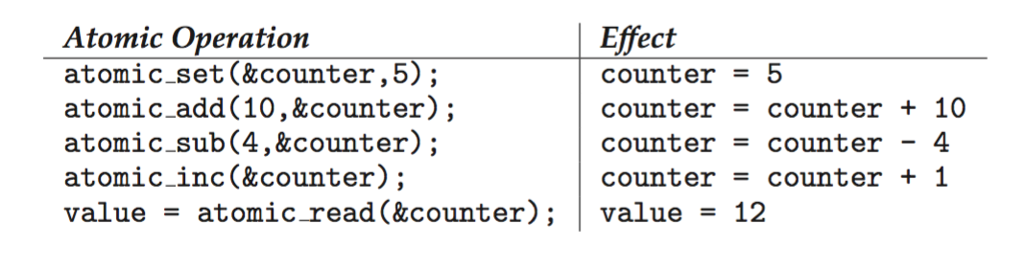
LINUX SYNCHRONIZATION
Atomic variable: atomic_t is the type for atomic integer
Consider the variables:
atomic_t counter; int value;
Consider the following codes:

Slide 29
POSIX SYNCHRONIZATION
POSIX API provides:
mutex locks
semaphores
condition variable
Widely used on UNIX, Linux, and macOS

Slide 30
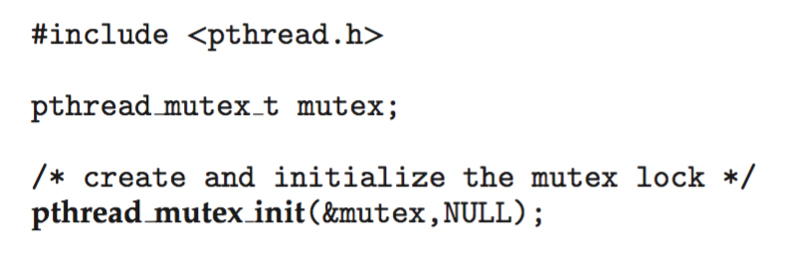
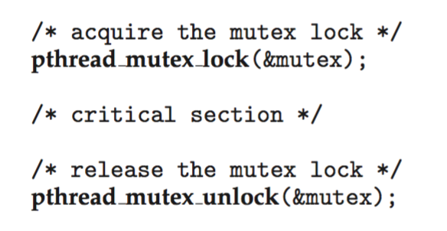
POSIX MUTEX LOCKS
Creating and initializing the lock
Acquiring and releasing the lock

Slide 31
POSIX SEMAPHORES
POSIX provides two versions:
Named semaphores
Can be used by unrelated processes
Unnamed semaphores
Cannot be used by unrelated processes

Slide 32
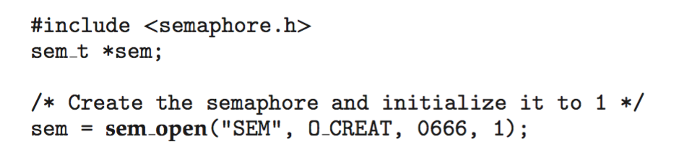
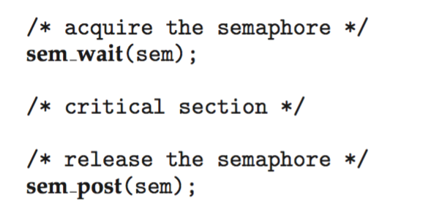
POSIX NAMED SEMAPHORES
Creating an initializing the semaphore:
Another process can access the semaphore by referring to its name SEM.
Acquiring and releasing the semaphore:

Slide 33
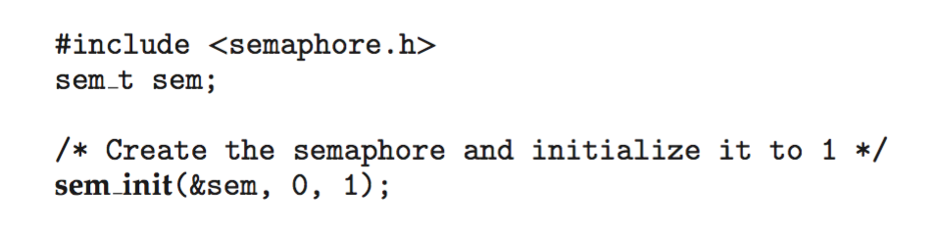
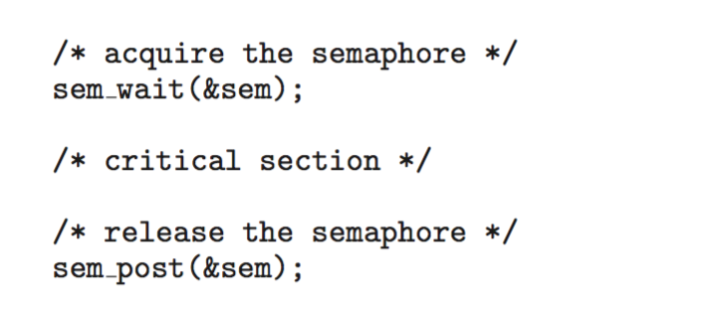
POSIX UNNAMED SEMAPHORES
Creating an initializing the semaphore:
Acquiring and releasing the semaphore:

Slide 34
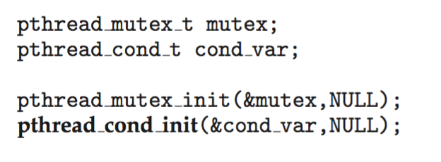
POSIX CONDITION VARIABLES
Since POSIX is typically used in C/C++ and these languages do not provide a monitor, POSIX condition variables are associated with a POSIX mutex lock to provide mutual exclusion:
Creating and initializing the condition variable

Slide 35
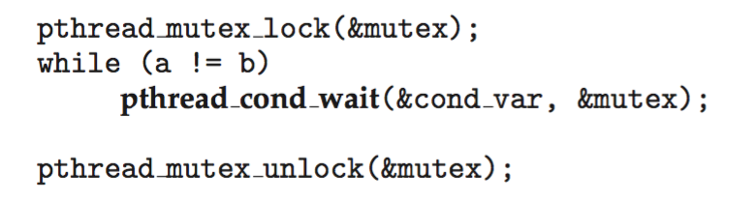
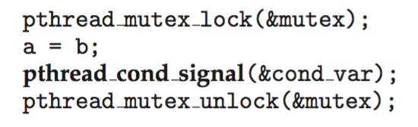
POSIX CONDITION VARIABLES
Thread waiting for the condition a == b to become true:
Thread signaling another thread waiting on the condition variable:

Slide 36
JAVA SYNCHRONIZATION
Java provides rich set of synchronization features:
Java Monitors
Reentrant locks
Semaphores
Condition variables

Slide 37
JAVA SYNCHRONIZATION: JAVA MONITORS
Every Java object has associated with it a single lock.
If a method is declared as synchronized, a calling thread must own the lock for the object.
If the lock is owned by another thread, the calling thread must wait for the lock until it is released.
Locks are released when the owning thread exits the synchronized method.

Slide 38
BOUNDED BUFFER USING JAVA SYNCHRONIZATION
public class BoundedBuffer<E>
{
private static final int BUFFER SIZE = 5;
private int count, in, out;
private E[] buffer;
public BoundedBuffer() {
count = 0;
in = 0;
out = 0;
buffer = (E[]) new Object[BUFFER SIZE];
}
/* Producers call this method */
public synchronized void insert(E item) {
/* See Figure 7.11 of Chapter 7 */
}
/* Consumers call this method */
public synchronized E remove() {
/* See Figure 7.11 of Chapter 7 */
}
}

Slide 39
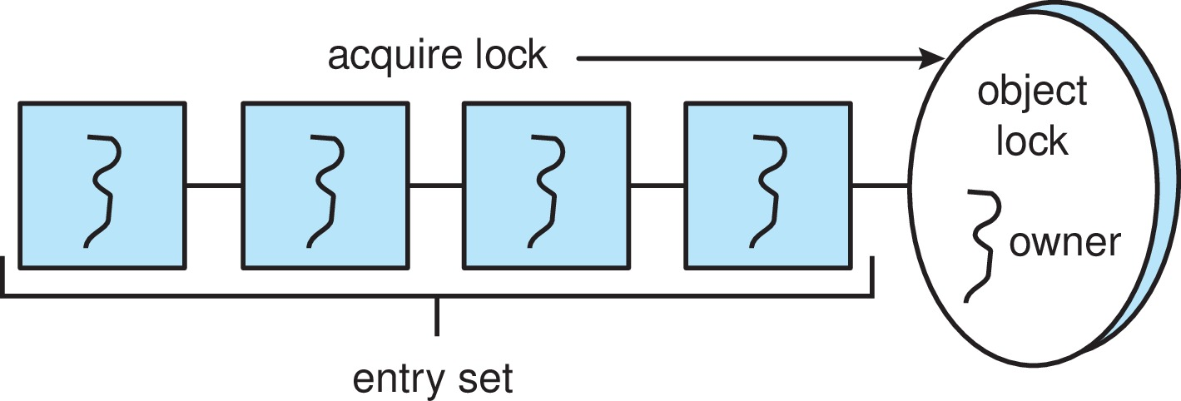
JAVA SYNCHRONIZATION
A thread that tries to acquire an unavailable lock is placed in the object’s entry set:

Slide 40
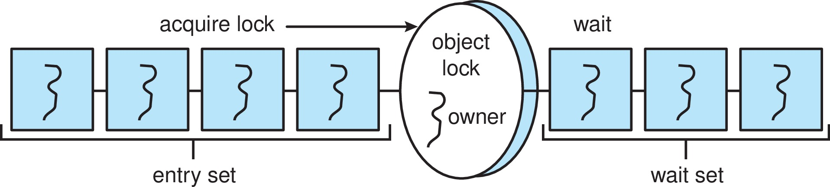
JAVA SYNCHRONIZATION
Similarly, each object also has a wait set.
When a thread calls wait():
It releases the lock for the object
The state of the thread is set to blocked
The thread is placed in the wait set for the object

Slide 41
JAVA SYNCHRONIZATION
A thread typically calls wait( ) when it is waiting for a condition to become true.
When a thread calls notify():
An arbitrary thread T is selected from the wait set
T is moved from the wait set to the entry set
Set the state of T from blocked to runnable
T can now compete for the lock to check if the condition it was waiting for is now true.

Slide 42
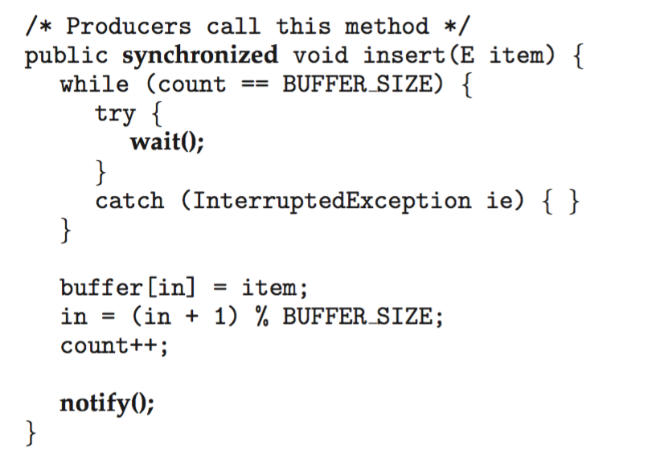
BOUNDED BUFFER – JAVA SYNCHRONIZATION

Slide 43
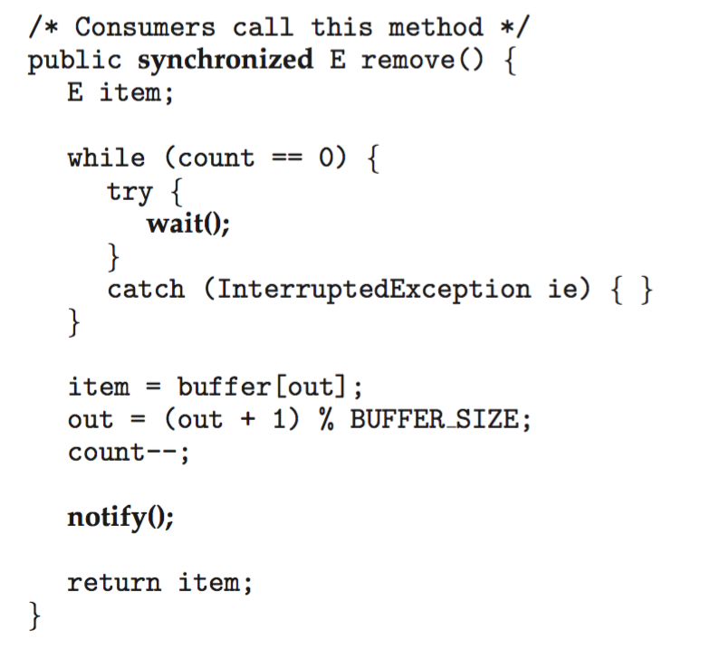
BOUNDED BUFFER – JAVA SYNCHRONIZATION

Slide 44
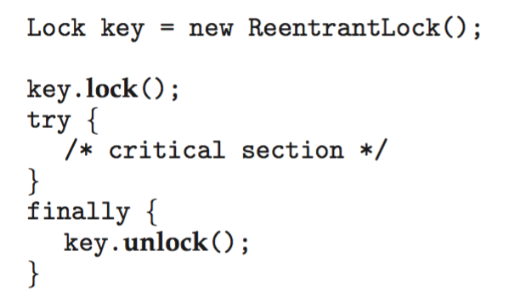
JAVA SYNCHRONIZATION: REENTRANT LOCKS
Similar to mutex locks
The finally clause ensures the lock will be released in case an exception occurs in the try block:

Slide 45
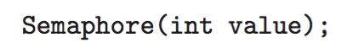
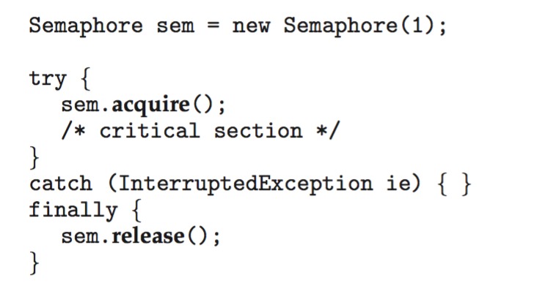
JAVA SYNCHRONIZATION: SEMAPHORES
Constructor:
Usage:

Slide 46
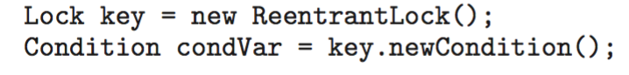
JAVA SYNCHRONIZATION: CONDITION VARIABLES
Condition variables are associated with an ReentrantLock.
Creating a condition variable using newCondition() method of ReentrantLock:
A thread waits by calling the await() method
A thread signals by calling the signal() method

Slide 47
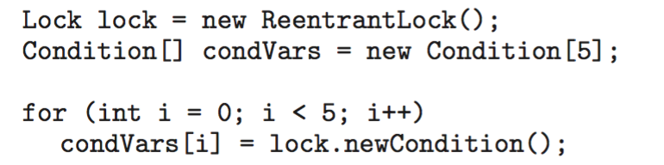
JAVA SYNCHRONIZATION: CONDITION VARIABLES
Example:
Five threads numbered 0 ... 4
Shared variable turn indicating which thread’s turn it is.
Thread calls doWork() when it wishes to do some work. (But it may only do work if it is their turn.)
If not their turn, wait
If it is their turn, do some work for awhile ……
When completed, notify the thread whose turn is next.
Necessary data structures:

Slide 48
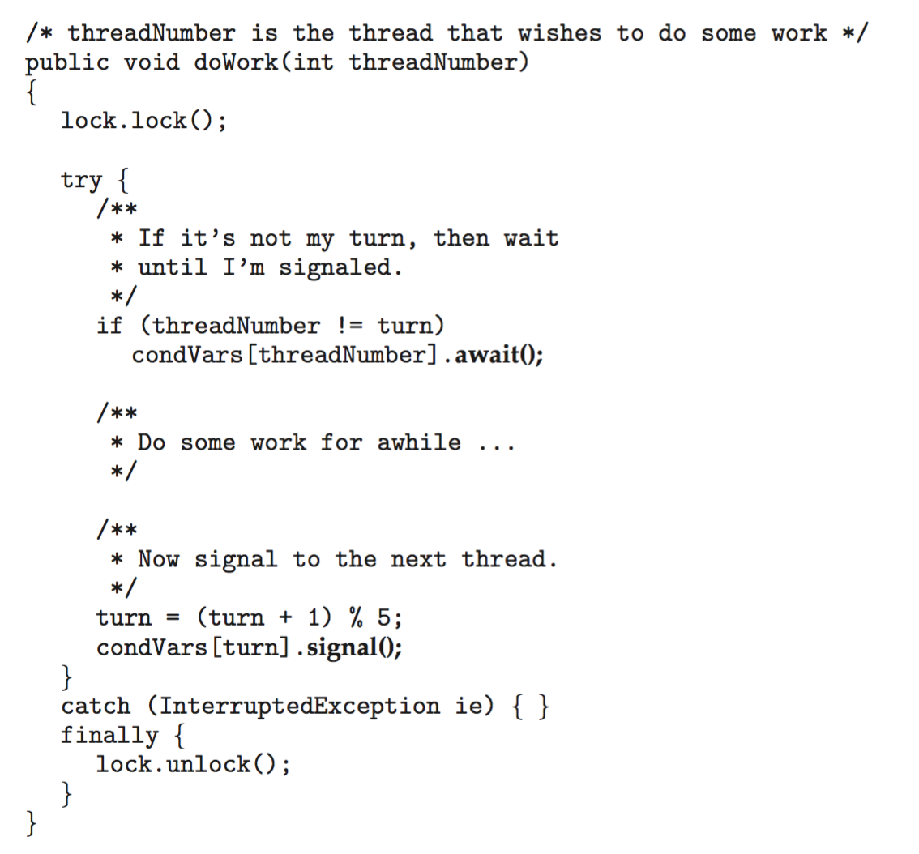
JAVA SYNCHRONIZATION: CONDITION VARIABLES

Slide 49
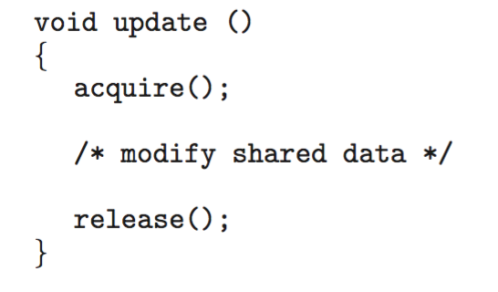
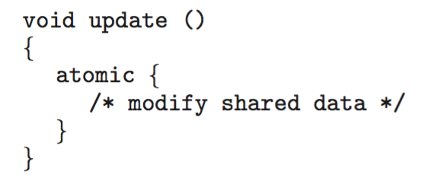
ALTERNATIVE APPROACH: TRANSACTIONAL MEMORY
Consider a function update( ) that must be called atomically.
One option is to use mutex locks:
Memory transaction:
a sequence of read-write operations to memory that are performed atomically.
a transaction can be completed by adding atomic{S} which ensure statements in S are executed atomically:

Slide 50
ALTERNATIVE APPROACH: OPENMP
OpenMP is a set of compiler directives and API that support parallel programming.
Critical Section compiler directive code:
The code contained within the #pragma omp critical directive is treated as a critical section and performed atomically.
void update(int value)
{
#pragma omp critical
{
counter += value;
}
}

Slide 51
ALTERNATIVE APPROACH: FUNCTIONAL PROGRAMMING LANGUAGES
Functional programming languages:
Offer a different paradigm than procedural languages in that they do not maintain state
Variables are treated as immutable and cannot change state once they have been assigned a value
There is increasing interest in functional languages such as Erlang and Scala for their approach in handling data races.

Slide 52
CS 3104 – OPERATING SYSTEMS
End of Chapter 7
Synchronization Examples

